Slide 1
Hand Written Digit Recognition Using ANN
Sourav Karmakar
souravkarmakar29@gmail.com

Slide 2
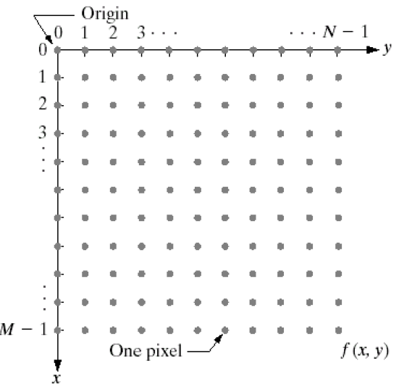
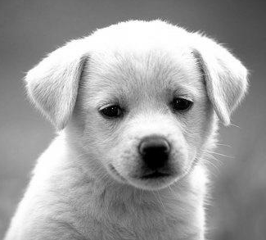
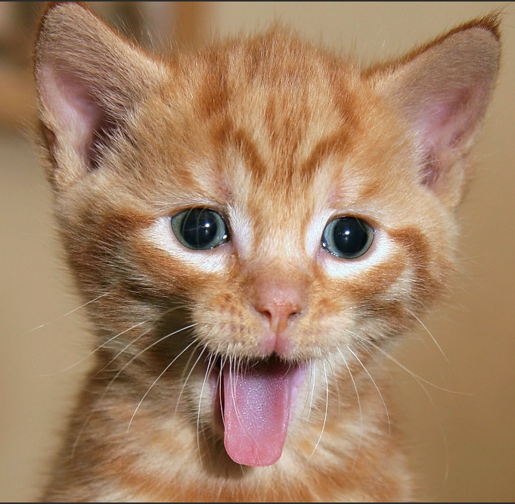
Basics: Digital Image
The digital images are nothing but discretized intensity values associated with discretized spatial co-ordinates
The digital images are of two types:
The Grayscale Images
The Colour Images
Each pixel values are integers and lies between 0 to 255
There are three values associated with each pixel. R,G,B. Each values are integers bet. 0 - 255
Extreme black is denoted as 0 and Extreme white is denoted as 255
0 denotes absence of that colour, 255 denotes fully presence of that colour.

Slide 3
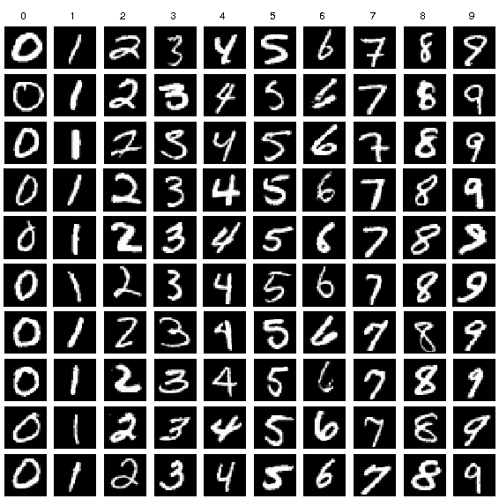
MNIST: Hand Written Digit Dataset
Contains 60000 training and 10000 test samples.
Each image is grayscale image of dimension $28×28$.
Each training and test sample also supplied with corresponding label.
There are total 10 classes. Digit-0 belongs to Class-0, Digit-1 belongs to Class-1,…, Digit-9 belongs to Class-9
Next we shall discuss about data pre-processing steps before discussing the architecture of the MLP for Hand Written Digit Recognition.

Slide 4
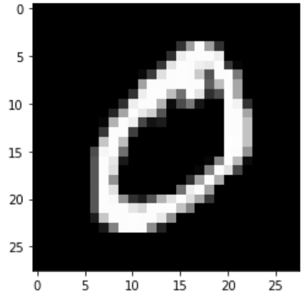
Data Preprocessing
Flattening the images:
Originally the training dataset is of dimension $60000×28×28$. As each image is of dimension $28×28$. So there are total $784$ pixels in each image.
Flatten
Flattened 1D array of Dimension 784
After flattening each image will become a one dimensional array of size 784 and the training data set shall become of size $60000×784$.
Similarly we flatten test dataset also. The $10000×28×28$ dimensional test dataset shall be of size $10000×784$ after flattening.

Slide 5
Data Preprocessing
Normalizing the data:
The digital image contains integer values between 0 – 255. First we have to convert the data type of the image from integer to float.
Then we have to divide the values in each pixel by 255.
This will ensure that each pixel will contain value between 0 to 1.
Normalization will help to stabilize the gradient descent algorithm.
Note that both training and test data have to be normalized.

Slide 6















Data Preprocessing
One Hot Encoding of the labels:
For Multiclass classification from each class labels / target values should be converted to one hot encoded vectors. Each one hot encoded vectors should have dimension = No. of Classes.
Images
Class Labels
One-Hot Encoded Vector
0
$${\left[1, 0, 0, 0, 0, 0, 0, 0, 0, 0\right]}^{T}$$
1
$${\left[0, 1, 0, 0, 0, 0, 0, 0, 0, 0\right]}^{T}$$
5
$${\left[0, 0, 0, 0, 0, 1, 0, 0, 0, 0\right]}^{T}$$
And similarly for other classes
As the output of the MLP will provide a probability distribution function hence we have to one-hot-encode the target variables.

Slide 7
ANN (MLP) Architecture
Single Hidden Layer Architecture:
784+1 neurons in the input layer
10 neurons in the output layer
Dense
Connection
Dense
Connection
Input Layer
Hidden Layer
Output Layer
Number of units same as input layer

Slide 8
ANN (MLP) Training
Batch Size:
Batch size is limited by the physical memory availability in the system and size of the each of the samples. If the available memory in the system is small choose smaller batch size (maybe 16 or 32). One can choose larger batch size if the available memory is more.
Number of Epochs:
Number of epochs should be reasonable. For less complex dataset smaller epochs are sufficient. However higher epochs will led to longer computation time.
Loss Function:
As we are using one-hot-encoded vector and in the output layer we are expecting to have a probability distribution, hence we shall use categorical cross entropy loss.
Optimizer:
We shall be using Adam optimizer. Optimizer ensures that while learning through backpropagation the network doesn’t halt in local minima. There are other types of optimizers as well.

Slide 9
Few Practical Considerations
Batch Normalization:
Batch normalization helps to obtain faster convergence. Though it is not always required.
Initialization:
Weights and bias should be initialized with small random numbers.
Check for convergence:
Plot the loss function vs epoch. If it is decreasing with acceptable rate then the network is converging. If it doesn’t decrease or very slowly decrease then we have to modify the network hypermeters until it shows convergence.
Activation function:
ReLU activation function in hidden units, and softmax at output layer.

Slide 10
Tensorflow And Keras
Tensorflow:
Tensorflow is a very popular, fast, scalable Machine Learning library. Tensorflow is one of the most sought after skills in present scenario.
In the context of ANN, tensorflow automatically computes the gradient, hence backpropagation becomes easier.
Complete documentation and how to install tensforflow in the system can be found: https://www.tensorflow.org/
Keras with tensorflow backend:
Tensorflow though excellent in performance it has one drawback and that is its complex syntaxes which makes it difficult for beginners.
Keras provides an easy API over tensorflow. It is comparatively much easier to use and with few lines of codes user can build and train NN very easily with keras.
For complete documentation on keras refer the website: https://keras.io/

Slide 11
Thank You

